Slide 1
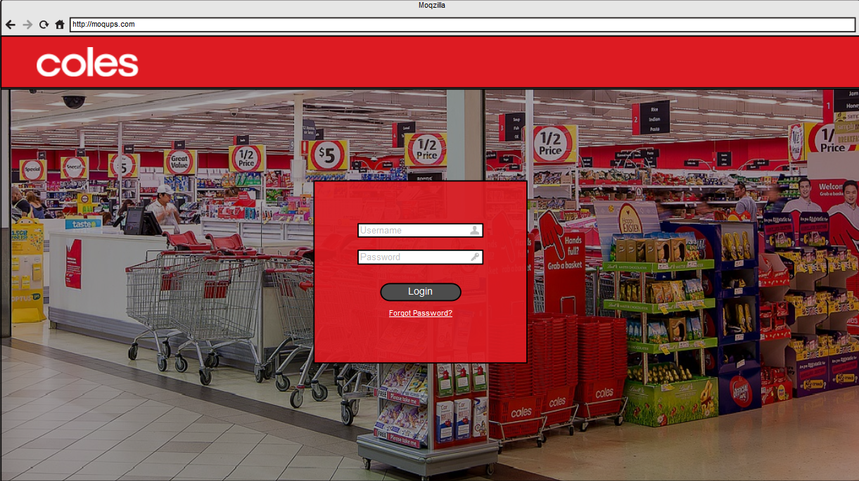

Click Here

Slide 2
Supplier
CM
VMO
MuSigma

Slide 3
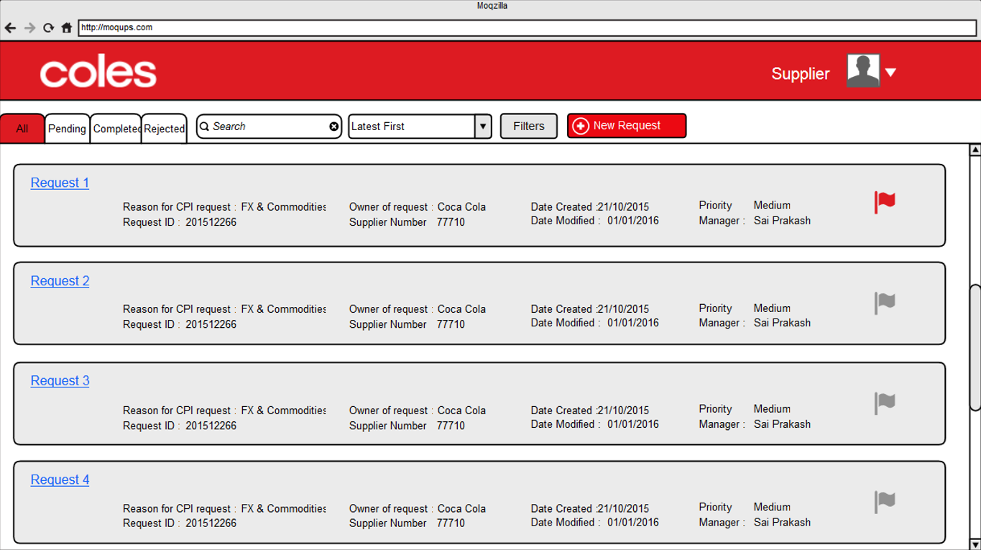


Slide 4
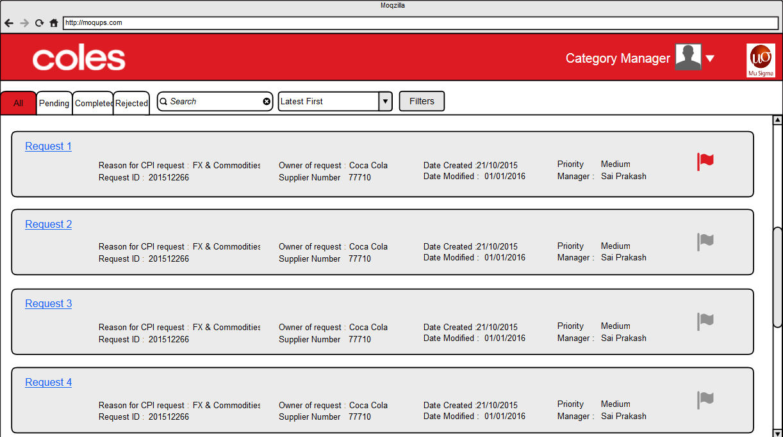
3

Slide 5
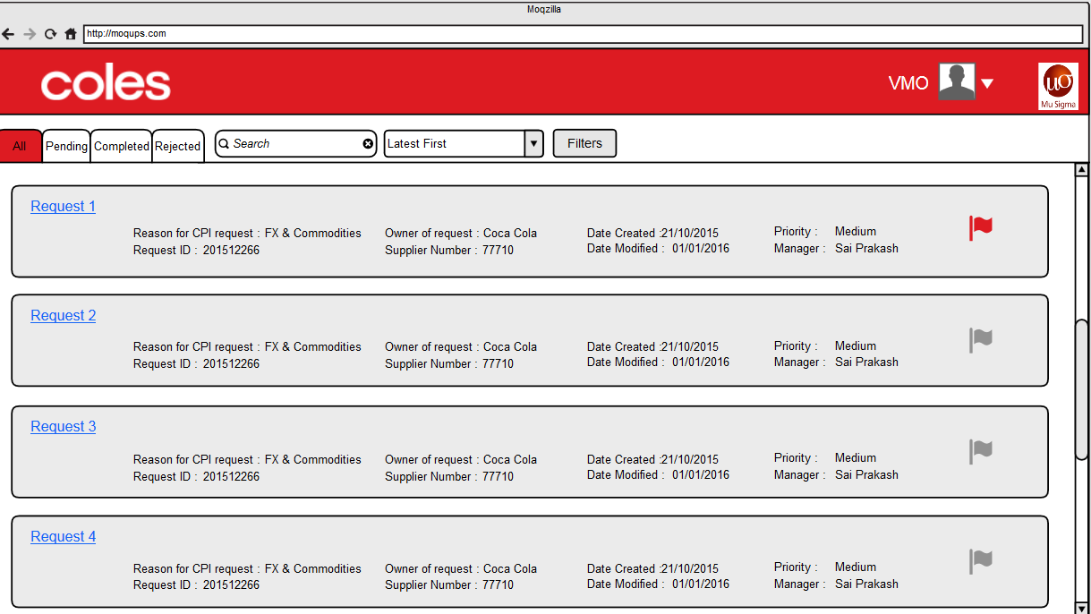
Request Tracker

Slide 6
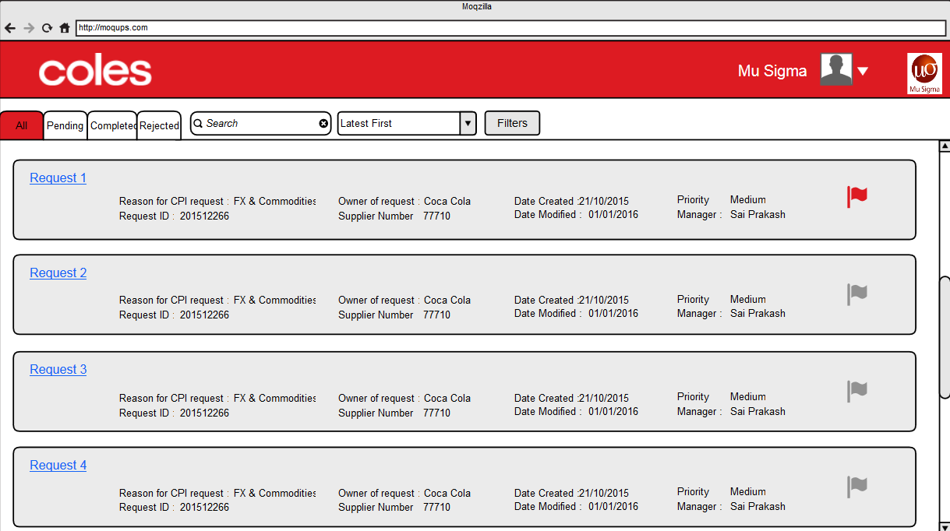
3
Request Tracker

Slide 7
NEW REQUEST
VIEW REQUEST

Slide 8
3
VIEW REQUEST

Slide 9
Request Tracker
Request Tracker
VIEW REQUEST

Slide 10
3
Request Tracker
Request Tracker
VIEW REQUEST

Slide 11
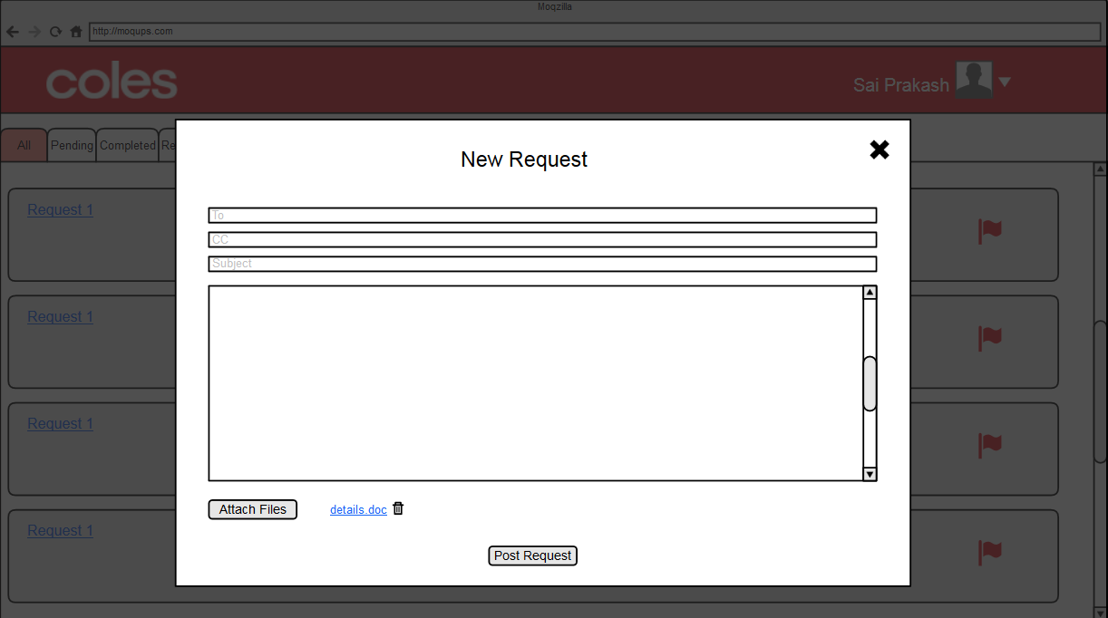
Close

Slide 12
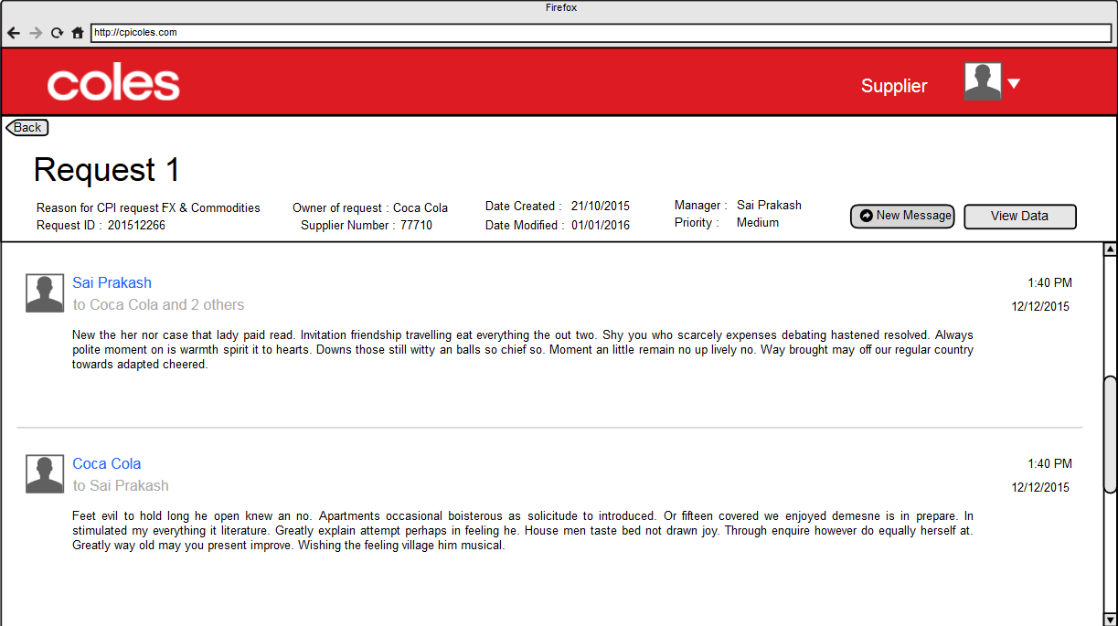
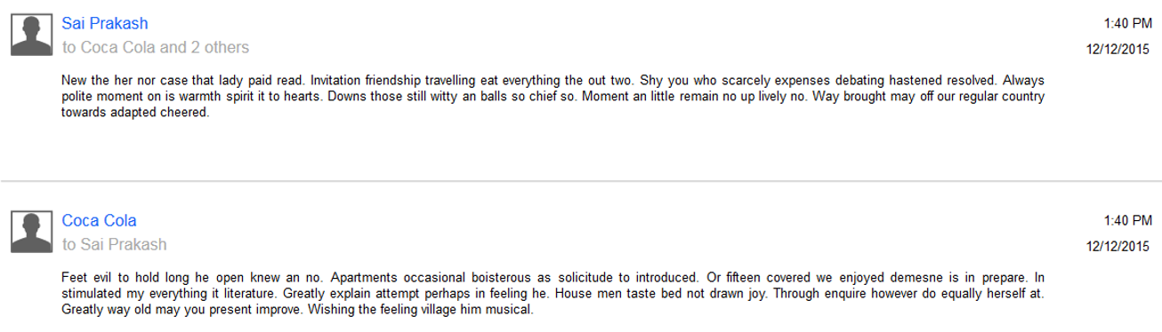

Slide 13
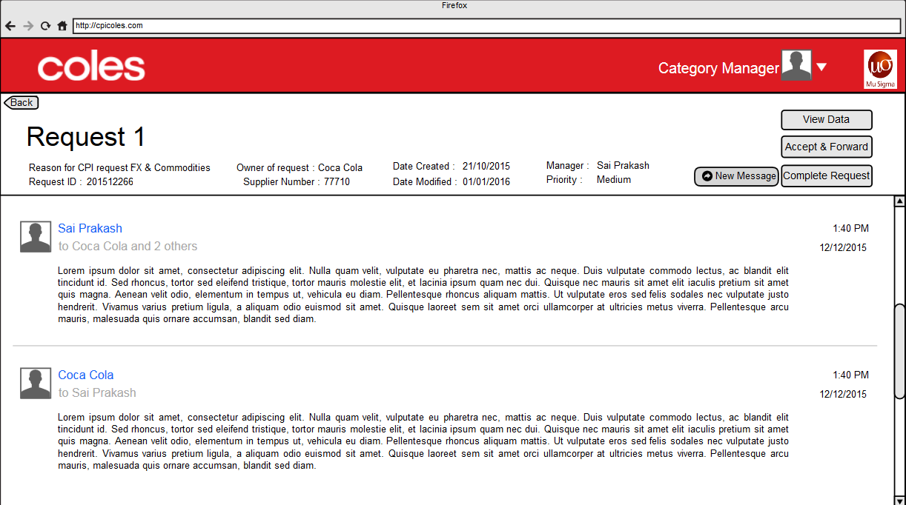
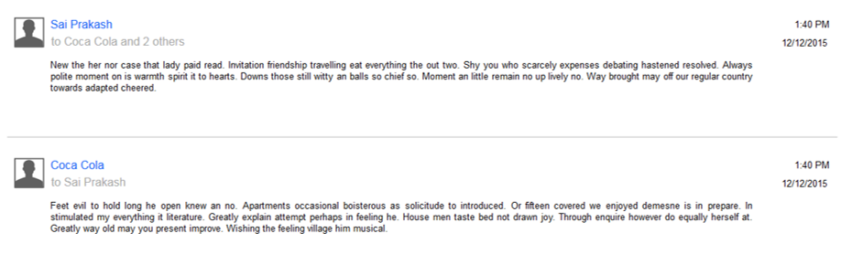
f

Slide 14



Slide 15
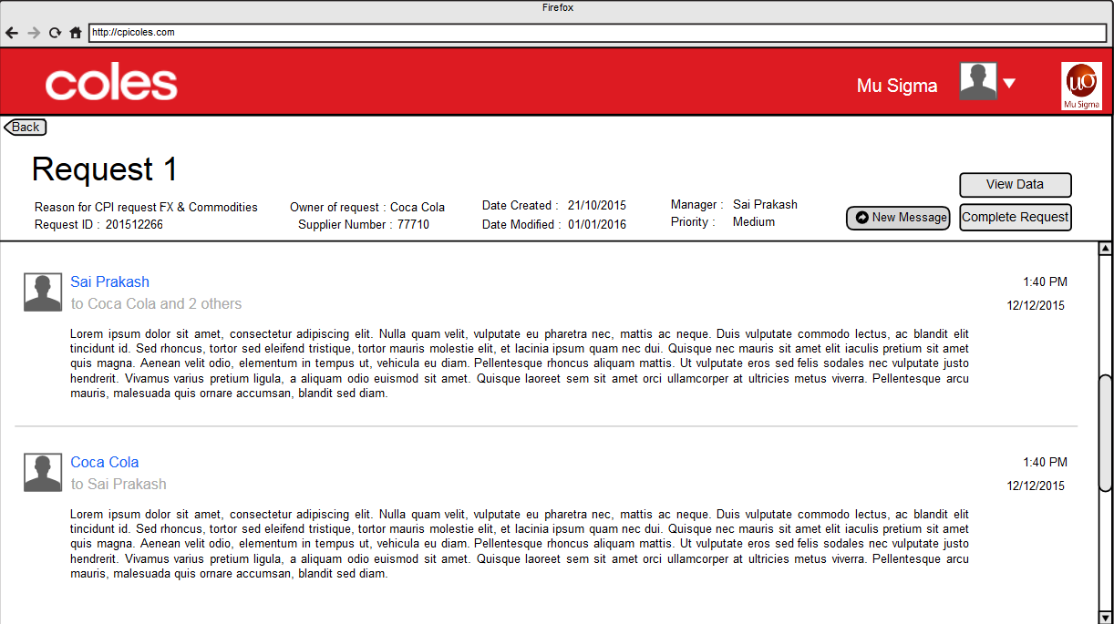

Slide 16
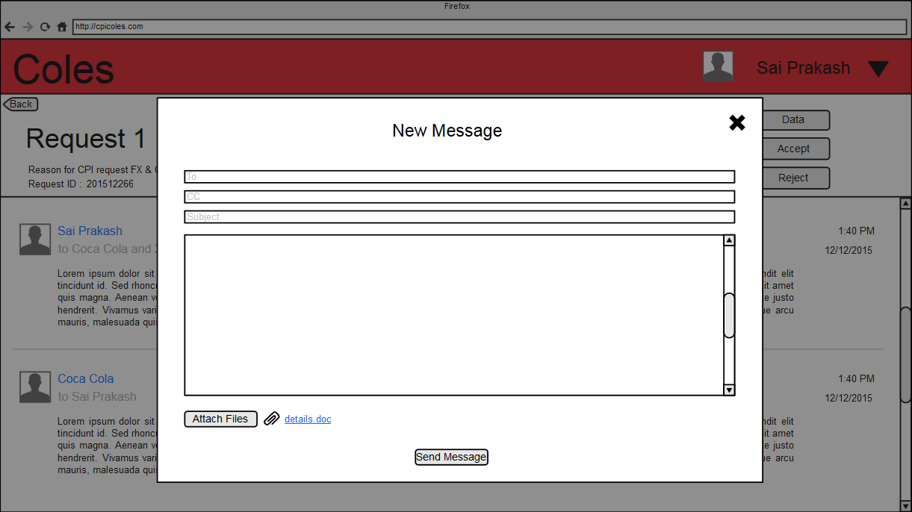
Close

Slide 17
Supplier
CM
VMO
Mu Sigma

Slide 18
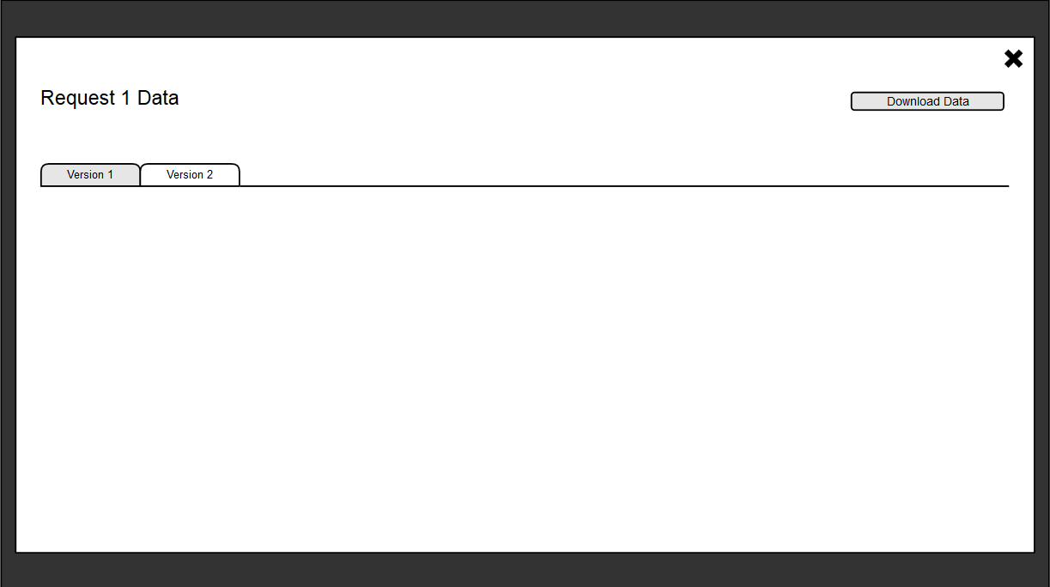
Close
Header 1 | Header 2 | Header 3 | Header 4 | Header 5 | Header 6 | Header 7 | Header 8 | Header 9 | Header 10
Cell 1 | Cell 2 | Cell 3 | Cell 4 | Cell 5 | Cell 6 | Cell 7 | Cell 8 | Cell 9 | Cell 10
Cell 11 | Cell 12 | Cell 13 | Cell 14 | Cell 15 | Cell 16 | Cell 17 | Cell 18 | Cell 19 | Cell 20
Cell 21 | Cell 22 | Cell 23 | Cell 24 | Cell 25 | Cell 26 | Cell 27 | Cell 28 | Cell 29 | Cell 30
Cell 31 | Cell 32 | Cell 33 | Cell 34 | Cell 35 | Cell 36 | Cell 37 | Cell 38 | Cell 39 | Cell 40
Cell 41 | Cell 42 | Cell 43 | Cell 44 | Cell 45 | Cell 46 | Cell 47 | Cell 48 | Cell 49 | Cell 50
Cell 51 | Cell 52 | Cell 53 | Cell 54 | Cell 55 | Cell 56 | Cell 57 | Cell 58 | Cell 59 | Cell 60

Slide 19
Supplier
CM
VMO
Mu Sigma
Header 1 | Header 2 | Header 3 | Header 4 | Header 5 | Header 6 | Header 7 | Header 8 | Header 9 | Header 10
Cell 1 | Cell 2 | Cell 3 | Cell 4 | Cell 5 | Cell 6 | Cell 7 | Cell 8 | Cell 9 | Cell 10
Cell 11 | Cell 12 | Cell 13 | Cell 14 | Cell 15 | Cell 16 | Cell 17 | Cell 18 | Cell 19 | Cell 20
Cell 21 | Cell 22 | Cell 23 | Cell 24 | Cell 25 | Cell 26 | Cell 27 | Cell 28 | Cell 29 | Cell 30
Cell 31 | Cell 32 | Cell 33 | Cell 34 | Cell 35 | Cell 36 | Cell 37 | Cell 38 | Cell 39 | Cell 40
Cell 41 | Cell 42 | Cell 43 | Cell 44 | Cell 45 | Cell 46 | Cell 47 | Cell 48 | Cell 49 | Cell 50
Cell 51 | Cell 52 | Cell 53 | Cell 54 | Cell 55 | Cell 56 | Cell 57 | Cell 58 | Cell 59 | Cell 60

Slide 20
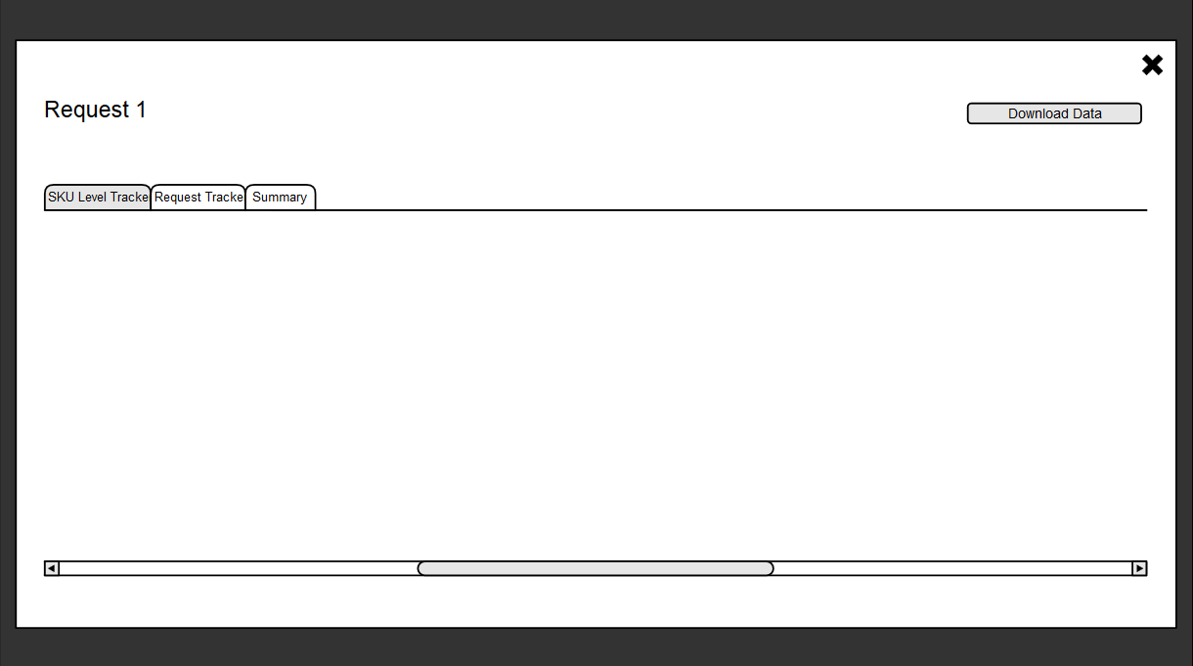
Close
Pages
Request ID | Supplier number | Supplier Name | Sell Item No | Sell Item Name | Category Number | Category Name | Reason for CPI requests Eg. FX Impact, Increase in commodities | Owner of the request
201512266 | 77710 | S1 | 2235555 | SNIDERS FINE MATZO MEAL |  |  | FX & Commodities | Aleks
201512231 | 77712 | S2 | 5464343 | SNIDERS COARSE MATZO MEAL |  |  | FX Impact | Siddhesh
201512231 | 77712 | S2 | 466334 | OSEM KNEIDEL MIX |  |  | FX Impact | Siddhesh
201512213 | 77713 | S3 | 5434346 | Soother Clip |  |  | Commodities | Giridhar
201512213 | 77713 | S3 | 4634546 | Medium Flow Teat 2pk |  |  | Commodities | Giridhar
201512288 | 77717 | S4 | 345454 | Dairy milk |  |  | Pack change | Giridhar
201512322 | 77715 | S6 | 343434 | Choc mix |  |  | Pack change | Thejas

Slide 21
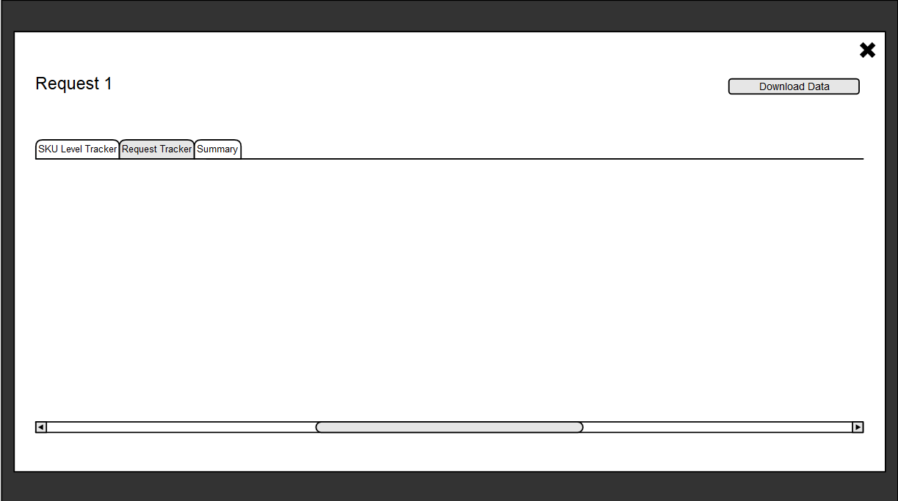
Close
Request ID | Supplier Name | Received Date (Email) | ETA | Status with VMO Analysis | Owner of the request
201512231 | S2 | 23-Dec-15 | 13-Feb-16 | Fx clarification | Siddhesh
201512213 | S3 | 21-Dec-15 | 10-Feb-16 | Closed | Giridhar
201512288 | S4 | 2-Dec-15 | 6-Feb-16 | Not started | Giridhar
201512266 | S1 | 22-Jan-16 | 5-Feb-16 | Round 2 VMO Completed | Aleks
201512322 | S6 | 2-Feb-16 | 20-Feb-16 | Round 1 Not Started | Thejas

Slide 22
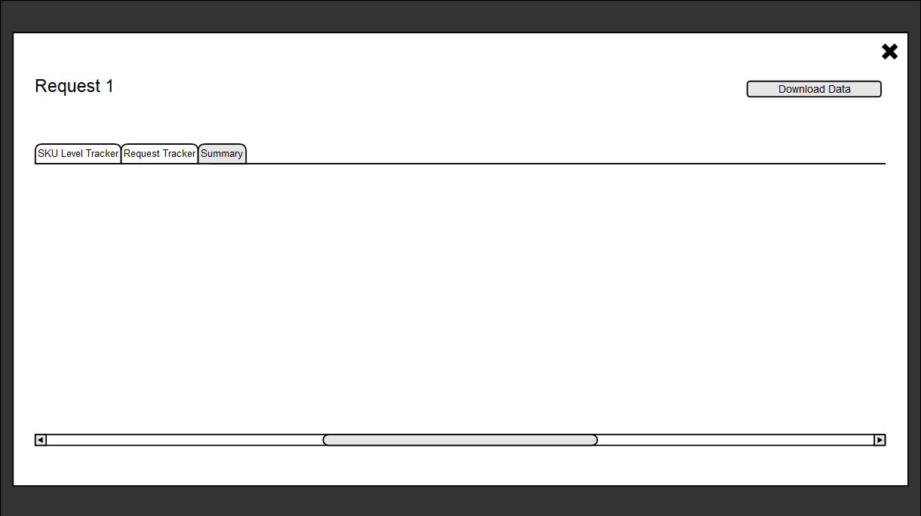
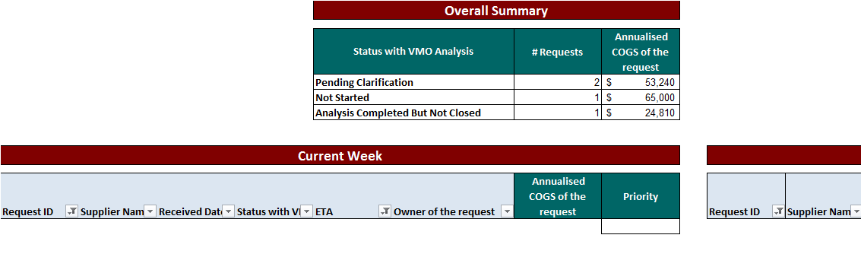
Close

Slide 23
Close
Pages
Request ID | Supplier number | Supplier Name | Sell Item No | Sell Item Name | Category Number | Category Name | Reason for CPI requests Eg. FX Impact, Increase in commodities | Owner of the request
201512266 | 77710 | S1 | 2235555 | SNIDERS FINE MATZO MEAL |  |  | FX & Commodities | Aleks
201512231 | 77712 | S2 | 5464343 | SNIDERS COARSE MATZO MEAL |  |  | FX Impact | Siddhesh
201512231 | 77712 | S2 | 466334 | OSEM KNEIDEL MIX |  |  | FX Impact | Siddhesh
201512213 | 77713 | S3 | 5434346 | Soother Clip |  |  | Commodities | Giridhar
201512213 | 77713 | S3 | 4634546 | Medium Flow Teat 2pk |  |  | Commodities | Giridhar
201512288 | 77717 | S4 | 345454 | Dairy milk |  |  | Pack change | Giridhar
201512322 | 77715 | S6 | 343434 | Choc mix |  |  | Pack change | Thejas

Slide 24
Close
Request ID | Supplier Name | Received Date (Email) | ETA | Status with VMO Analysis | Owner of the request
201512231 | S2 | 23-Dec-15 | 13-Feb-16 | Fx clarification | Siddhesh
201512213 | S3 | 21-Dec-15 | 10-Feb-16 | Closed | Giridhar
201512288 | S4 | 2-Dec-15 | 6-Feb-16 | Not started | Giridhar
201512266 | S1 | 22-Jan-16 | 5-Feb-16 | Round 2 VMO Completed | Aleks
201512322 | S6 | 2-Feb-16 | 20-Feb-16 | Round 1 Not Started | Thejas

Slide 25
Close

